Slide 1


Introduction to CRM Software
CRM software is a powerful tool that helps businesses manage and improve their customer relationships. It's used by companies of all sizes to optimize sales, marketing, and customer service processes.
Timothy opiyo

Slide 2

Defining CRM Software
CRM stands for Customer Relationship Management. CRM software is designed to centralize and manage all interactions with customers, from initial contact to ongoing support. This enables businesses to understand their customers better and personalize their interactions.
Customer Management
CRM software provides a comprehensive view of each customer, including their purchase history, preferences, and interactions with your company. This data helps you to personalize your communications and tailor your offerings.
Sales Automation
Automating sales tasks such as lead generation, follow-up, and proposal creation allows sales teams to focus on building relationships and closing deals.
Marketing Automation
CRM software streamlines marketing campaigns by automating tasks like email marketing, social media engagement, and lead nurturing. This helps you to reach the right customers with the right message at the right time.
Customer Service
CRM software provides tools for managing support tickets, tracking customer issues, and resolving problems quickly and efficiently. This helps to improve customer satisfaction and loyalty.

Slide 3

Key Features of CRM Software
CRM software includes several key features that help businesses achieve their customer relationship management goals.
1
Contact Management
Centralized database for storing and managing customer information.
2
Sales Pipeline Management
Track the progress of sales opportunities and manage your sales pipeline effectively.
3
Marketing Automation
Automate marketing tasks such as email campaigns, social media updates, and lead nurturing.
4
Customer Service Ticketing
Manage customer support requests, track issues, and provide timely resolutions.

Slide 4
Benefits of Implementing CRM Software
Implementing CRM software can have a transformative impact on your business operations.
Improved Customer Relationships
Increased Efficiency
Enhanced Decision-Making
Automating tasks such as lead generation, follow-up, and customer support reduces manual work, freeing up employees to focus on higher-value activities.
By providing a comprehensive view of customer interactions and preferences, CRM software allows you to personalize your communications and tailor your offerings to meet individual needs.
CRM software provides real-time data and analytics that can be used to identify trends, understand customer behavior, and make informed decisions.

Slide 5




Improved Customer Engagement and Retention
CRM software enables businesses to build stronger relationships with customers by providing personalized experiences and improving customer satisfaction.
Personalized Communications
CRM software allows you to segment your customers based on their preferences and send them targeted messages.
Proactive Support
CRM software can be used to identify customer issues before they escalate and provide proactive support.
Customer Feedback
CRM software provides tools for collecting customer feedback and using it to improve your products and services.

Slide 6
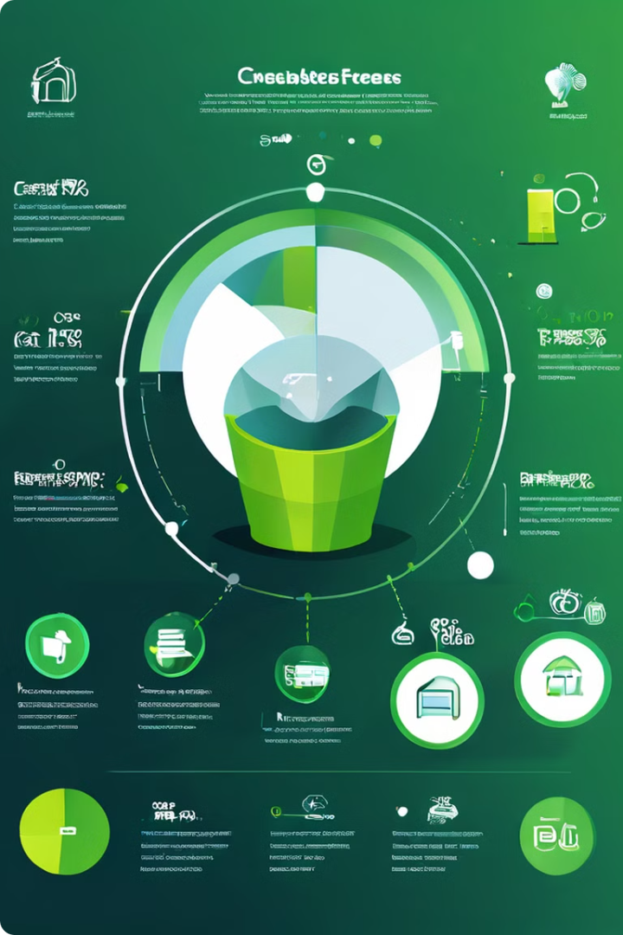
Enhanced Sales and Marketing Efficiency
CRM software streamlines sales and marketing processes, resulting in improved efficiency and increased productivity.
Lead Generation
Automate lead capture forms and generate leads from various sources.
Lead Qualification
Score leads based on their potential and prioritize them for follow-up.
Sales Pipeline Management
Track the progress of sales opportunities and manage your sales pipeline effectively.
Marketing Automation
Automate marketing tasks such as email campaigns, social media updates, and lead nurturing.

Slide 7





Data-Driven Decision Making
CRM software provides businesses with valuable data insights that can be used to make informed decisions.
Sales Performance
Track sales metrics like conversion rates, average deal size, and customer lifetime value.
Customer Behavior
Analyze customer interactions, purchase patterns, and preferences to understand their needs.
Marketing Effectiveness
Measure the success of marketing campaigns and optimize your marketing strategies.
Customer Satisfaction
Track customer satisfaction scores, feedback, and complaints to identify areas for improvement.

Slide 8

Conclusion: The Transformative Impact of CRM Software
CRM software has revolutionized the way businesses interact with and manage their customers. By centralizing customer data, automating processes, and providing valuable insights, CRM software empowers businesses to build stronger relationships, improve customer satisfaction, and drive growth.

